Slide 1
Exploring the World of Digital Devices: CEIS 114
Sukhmeen Grewal

Slide 2
Introduction to Digital devices
In today's connected world, IoT-enabled devices have become an integral part of our daily lives, and they rely on a specific set of components to perform their functions.
These IoT systems are not just digital; they're a fusion of digital and physical, combining sensors, controllers, and actuators to achieve their intended purposes.
IoT encompasses a wide range of devices, including smart home gadgets, industrial sensors, wearable technology, and more. Each type serves specific purposes, but they all share these common elements.
As we embrace the IoT era, it's crucial to consider the security and privacy implications of the data collected and transmitted by these devices.

Slide 3
Devices and Components
Digital Device (Central Processor)
Sensors
Controllers
Actuators
Power Sources
Firmware and Software

Slide 4
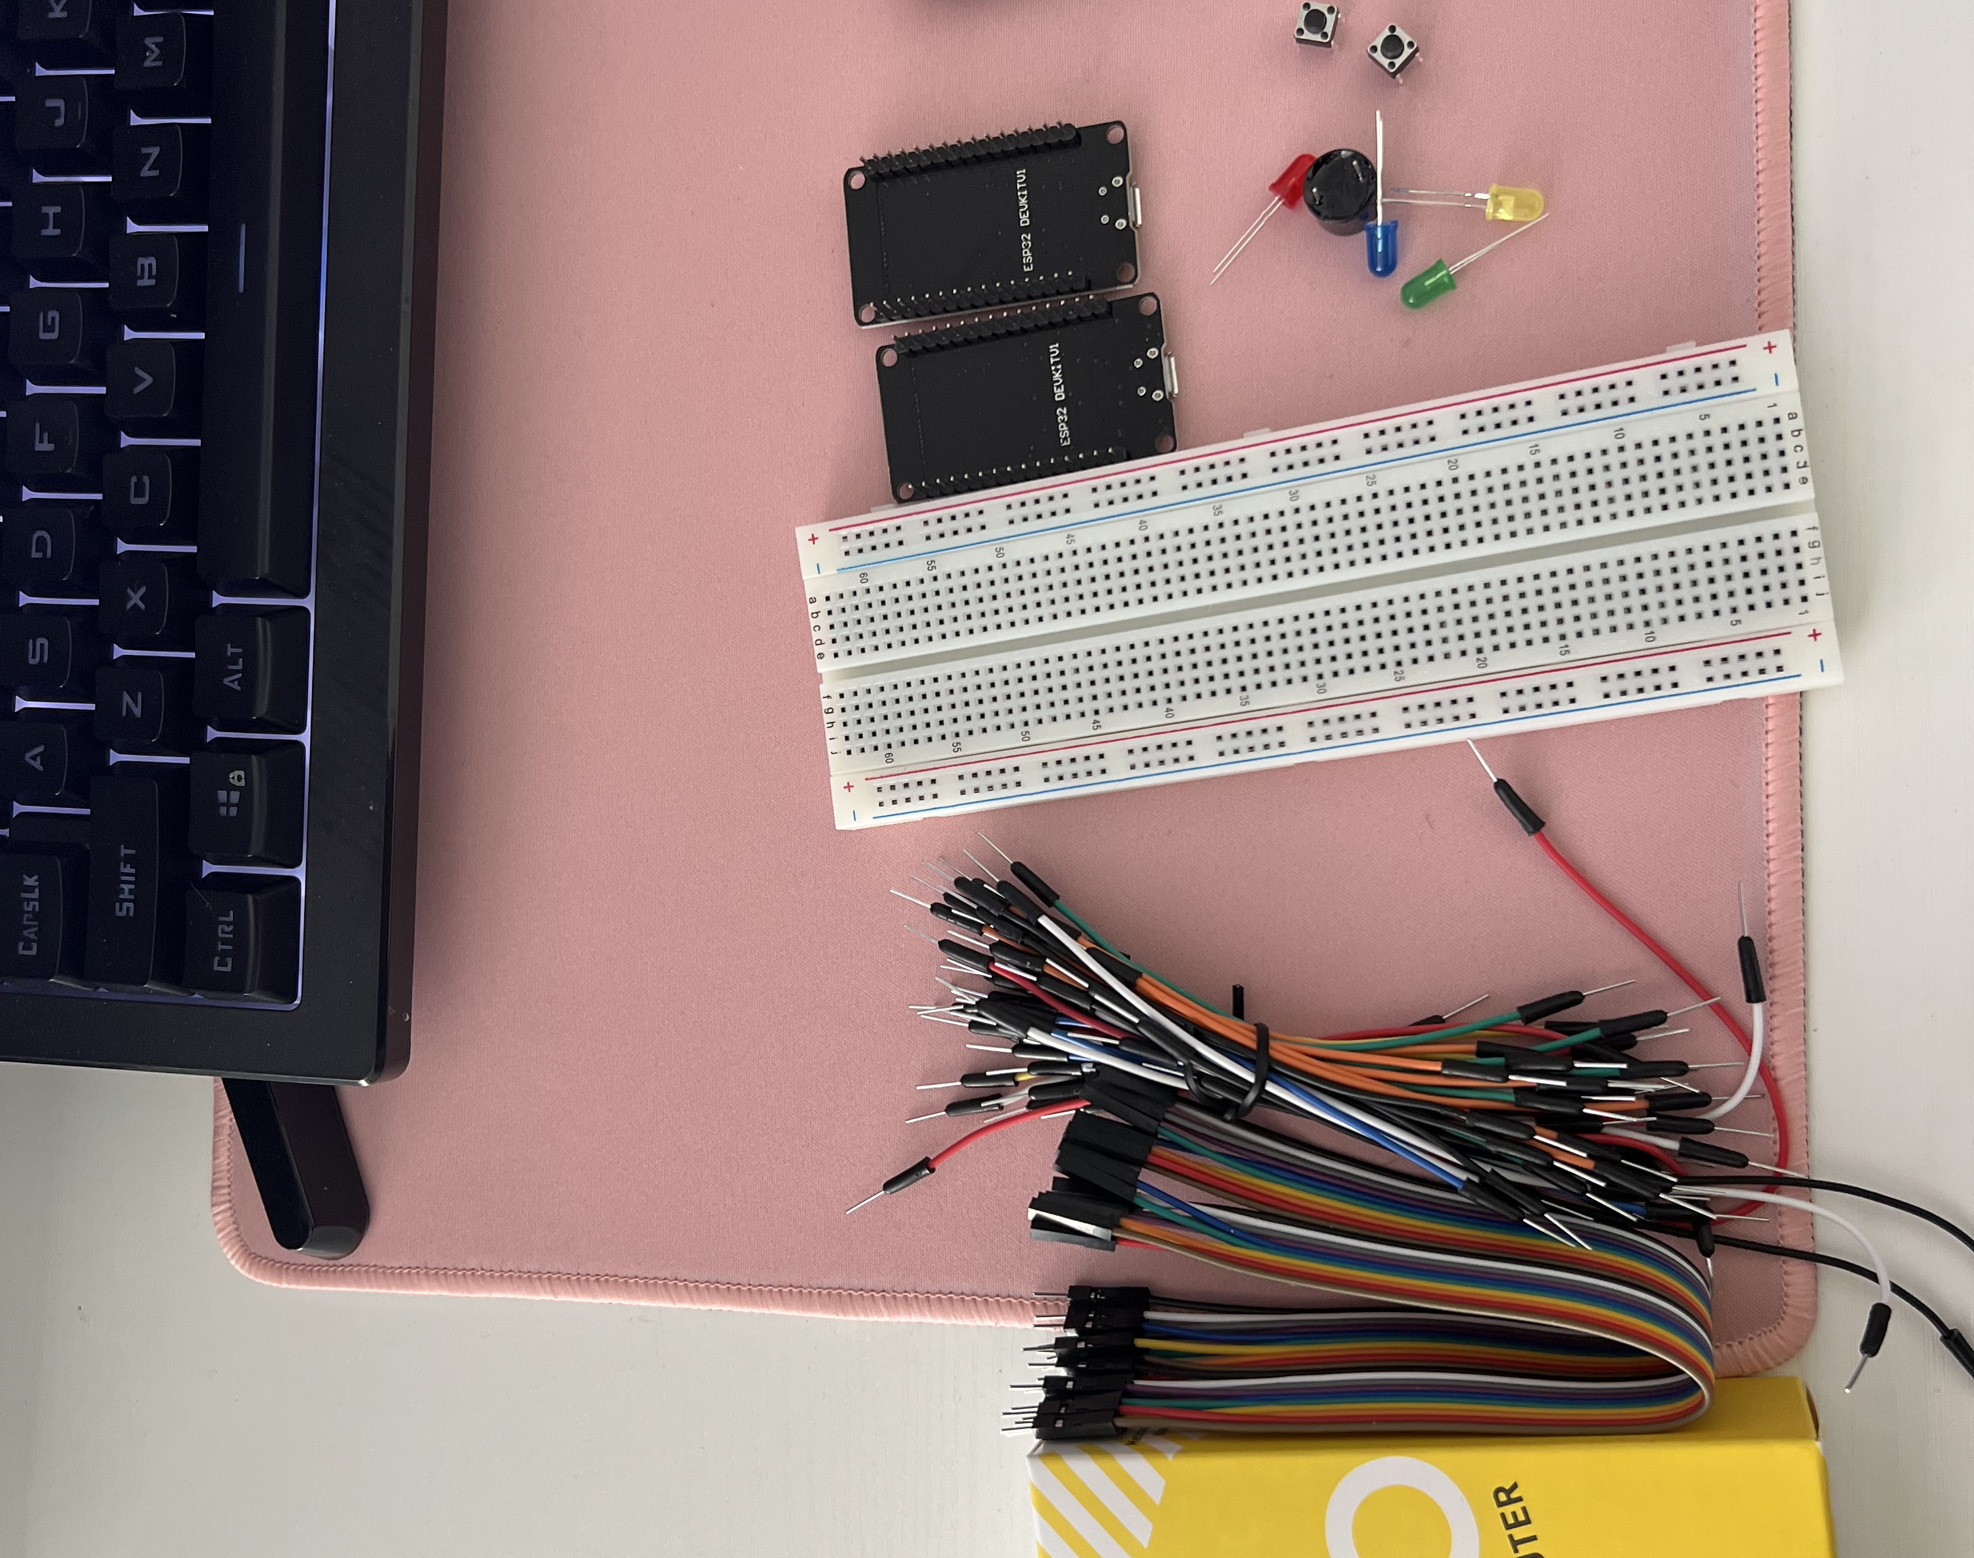
Inventory
ESP 32 Board
Colored LEDs: Red, Yellow, Green, and Blue
220 Ohm Resistors (optional)
Wires
Breadboard(s)
LCD Unit with I2C Adapter
Active Buzzer
Mini Router
Push Button(s)
PIR Motion Sensor

Slide 5
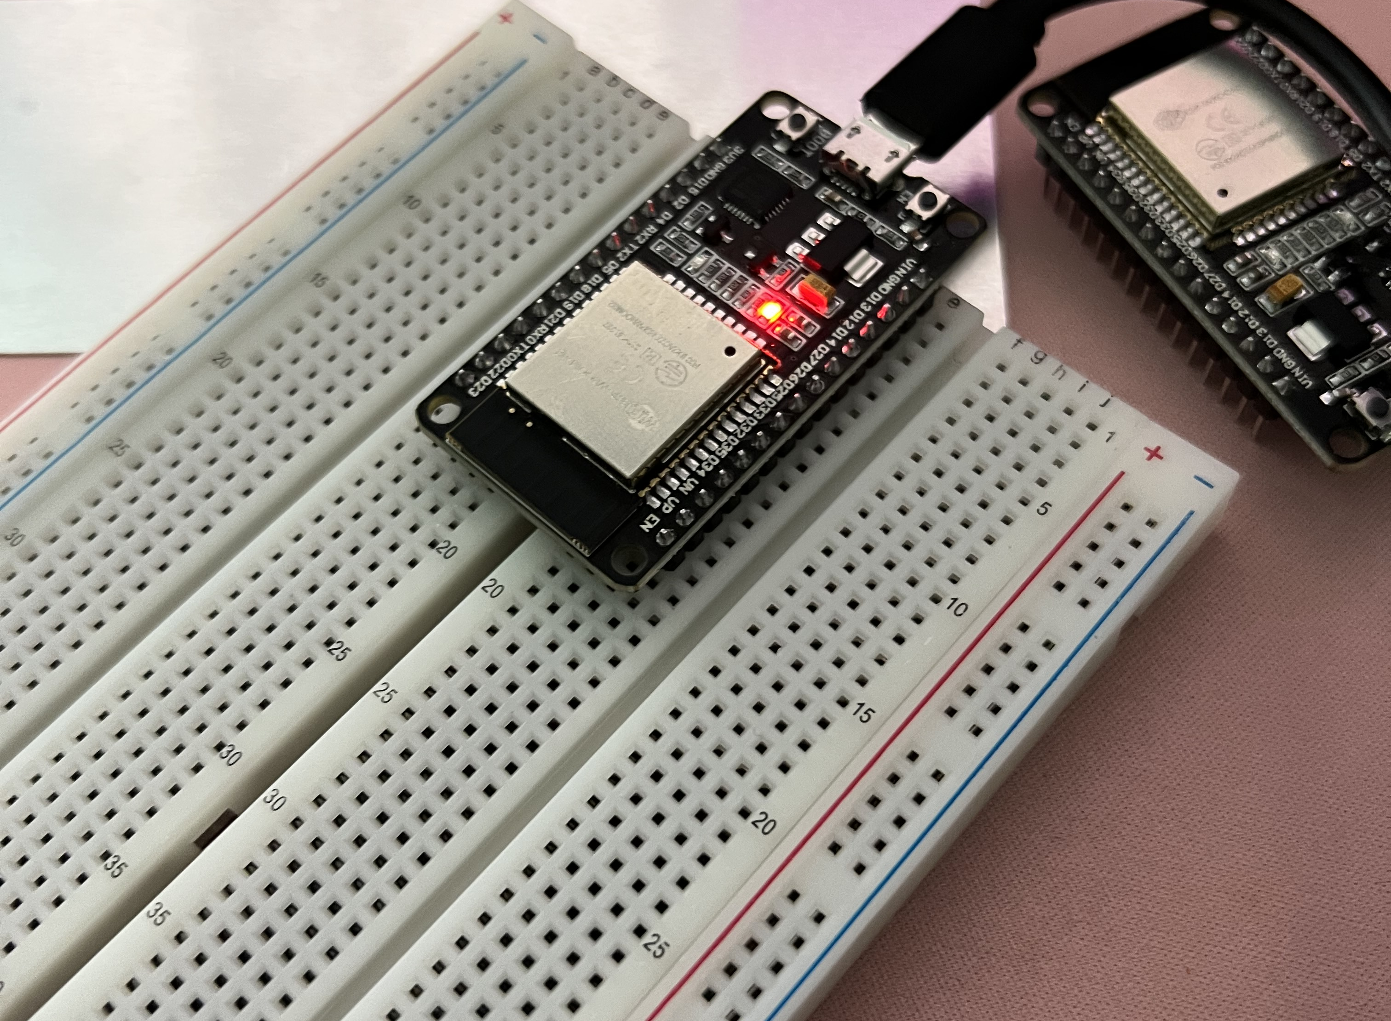
ESP32
Microcontroller mounted and powered ON

Slide 6
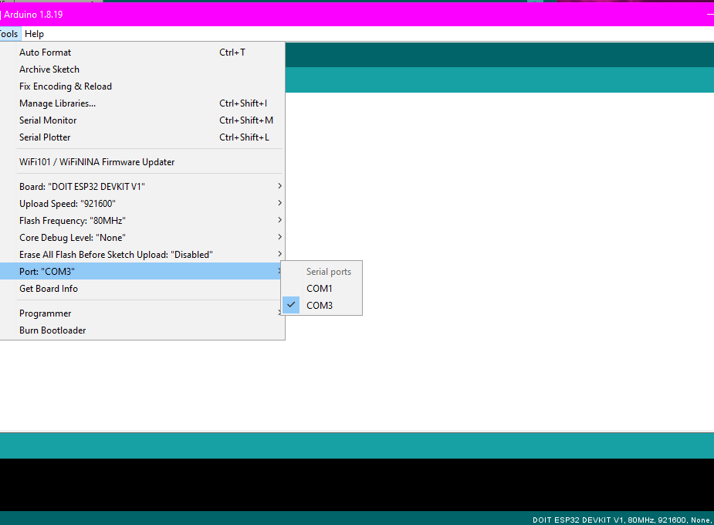
Installation of Arduino IDE
Arduino IDE with Port selected from Tools menu.

Slide 7
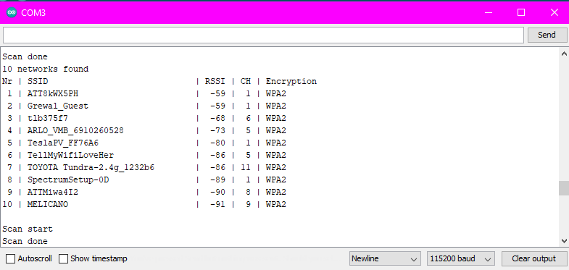
ESP32 WiFi Scan
Serial Monitor in Arduino IDE showing the available networks

Slide 8
Digital Foundations 1
Digital technology is the backbone of the modern world, influencing communication, work, play, and innovation. These foundational concepts pave the way for understanding advanced digital technology topics, making them accessible to all.
Binary Code
Bit vs. Byte
Digital vs. Analog
Data Representation
Information Storage

Slide 9
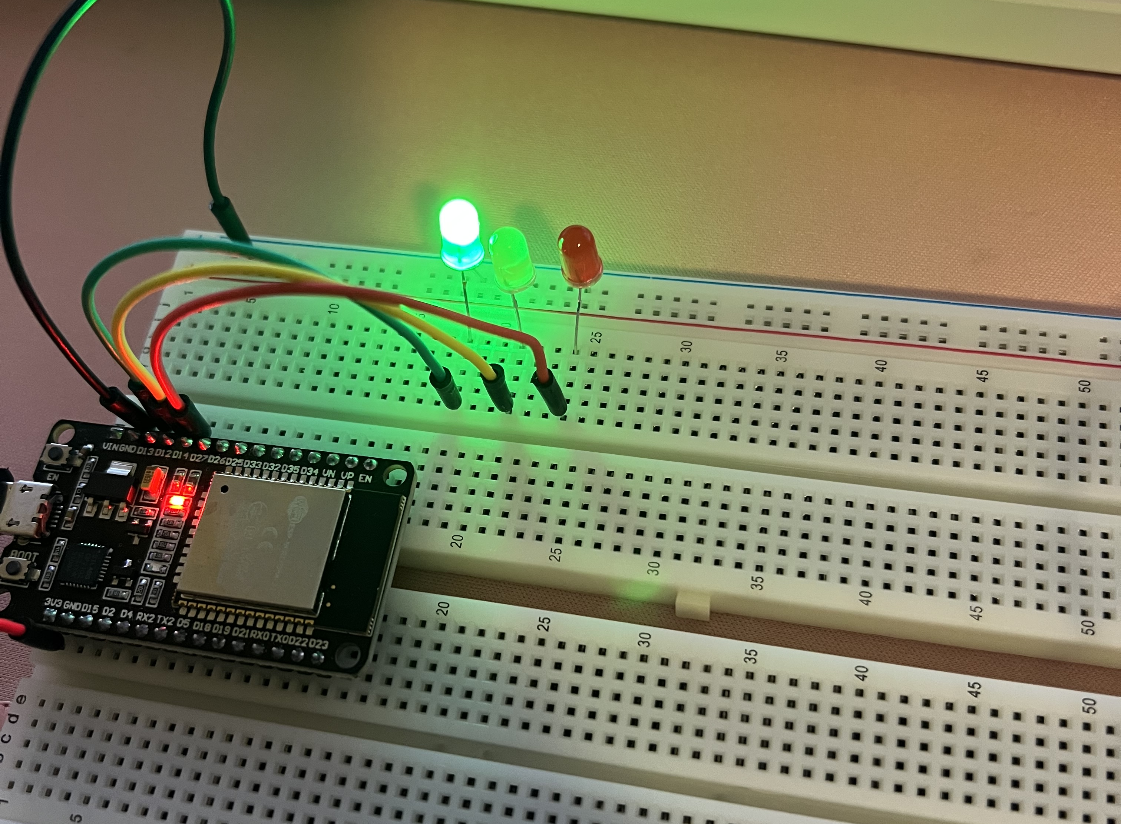
Circuit with working LEDs
Step 1: Hardware Setup
Step 2: Wiring Connections
Step 3: Arduino IDE Configuration
Step 4: Connect the ESP32 Board
Insert Red, Yellow, and Green LEDs into the breadboard, connect wires, open the Arduino IDE and load the code, verify that the Arduino IDE recognizes the ESP32 Board

Slide 10
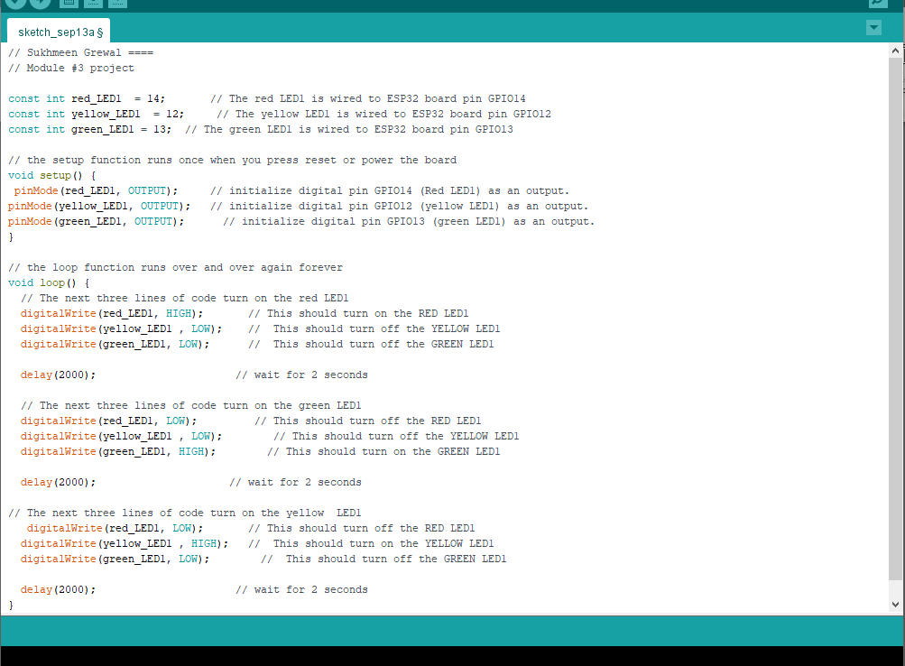
Code in Arduino IDE
Code for one traffic light

Slide 11
Digital foundations 2
Exploring the theory and practical implementation of state machines, a fundamental concept in digital systems.
Diving into the world of digital integrated circuits and learning about microcontrollers, microprocessors, and field-programmable gate arrays (FPGAs).
Uncovering the realm of embedded systems, understanding their role in various applications, and how they impact our daily lives.

Slide 12
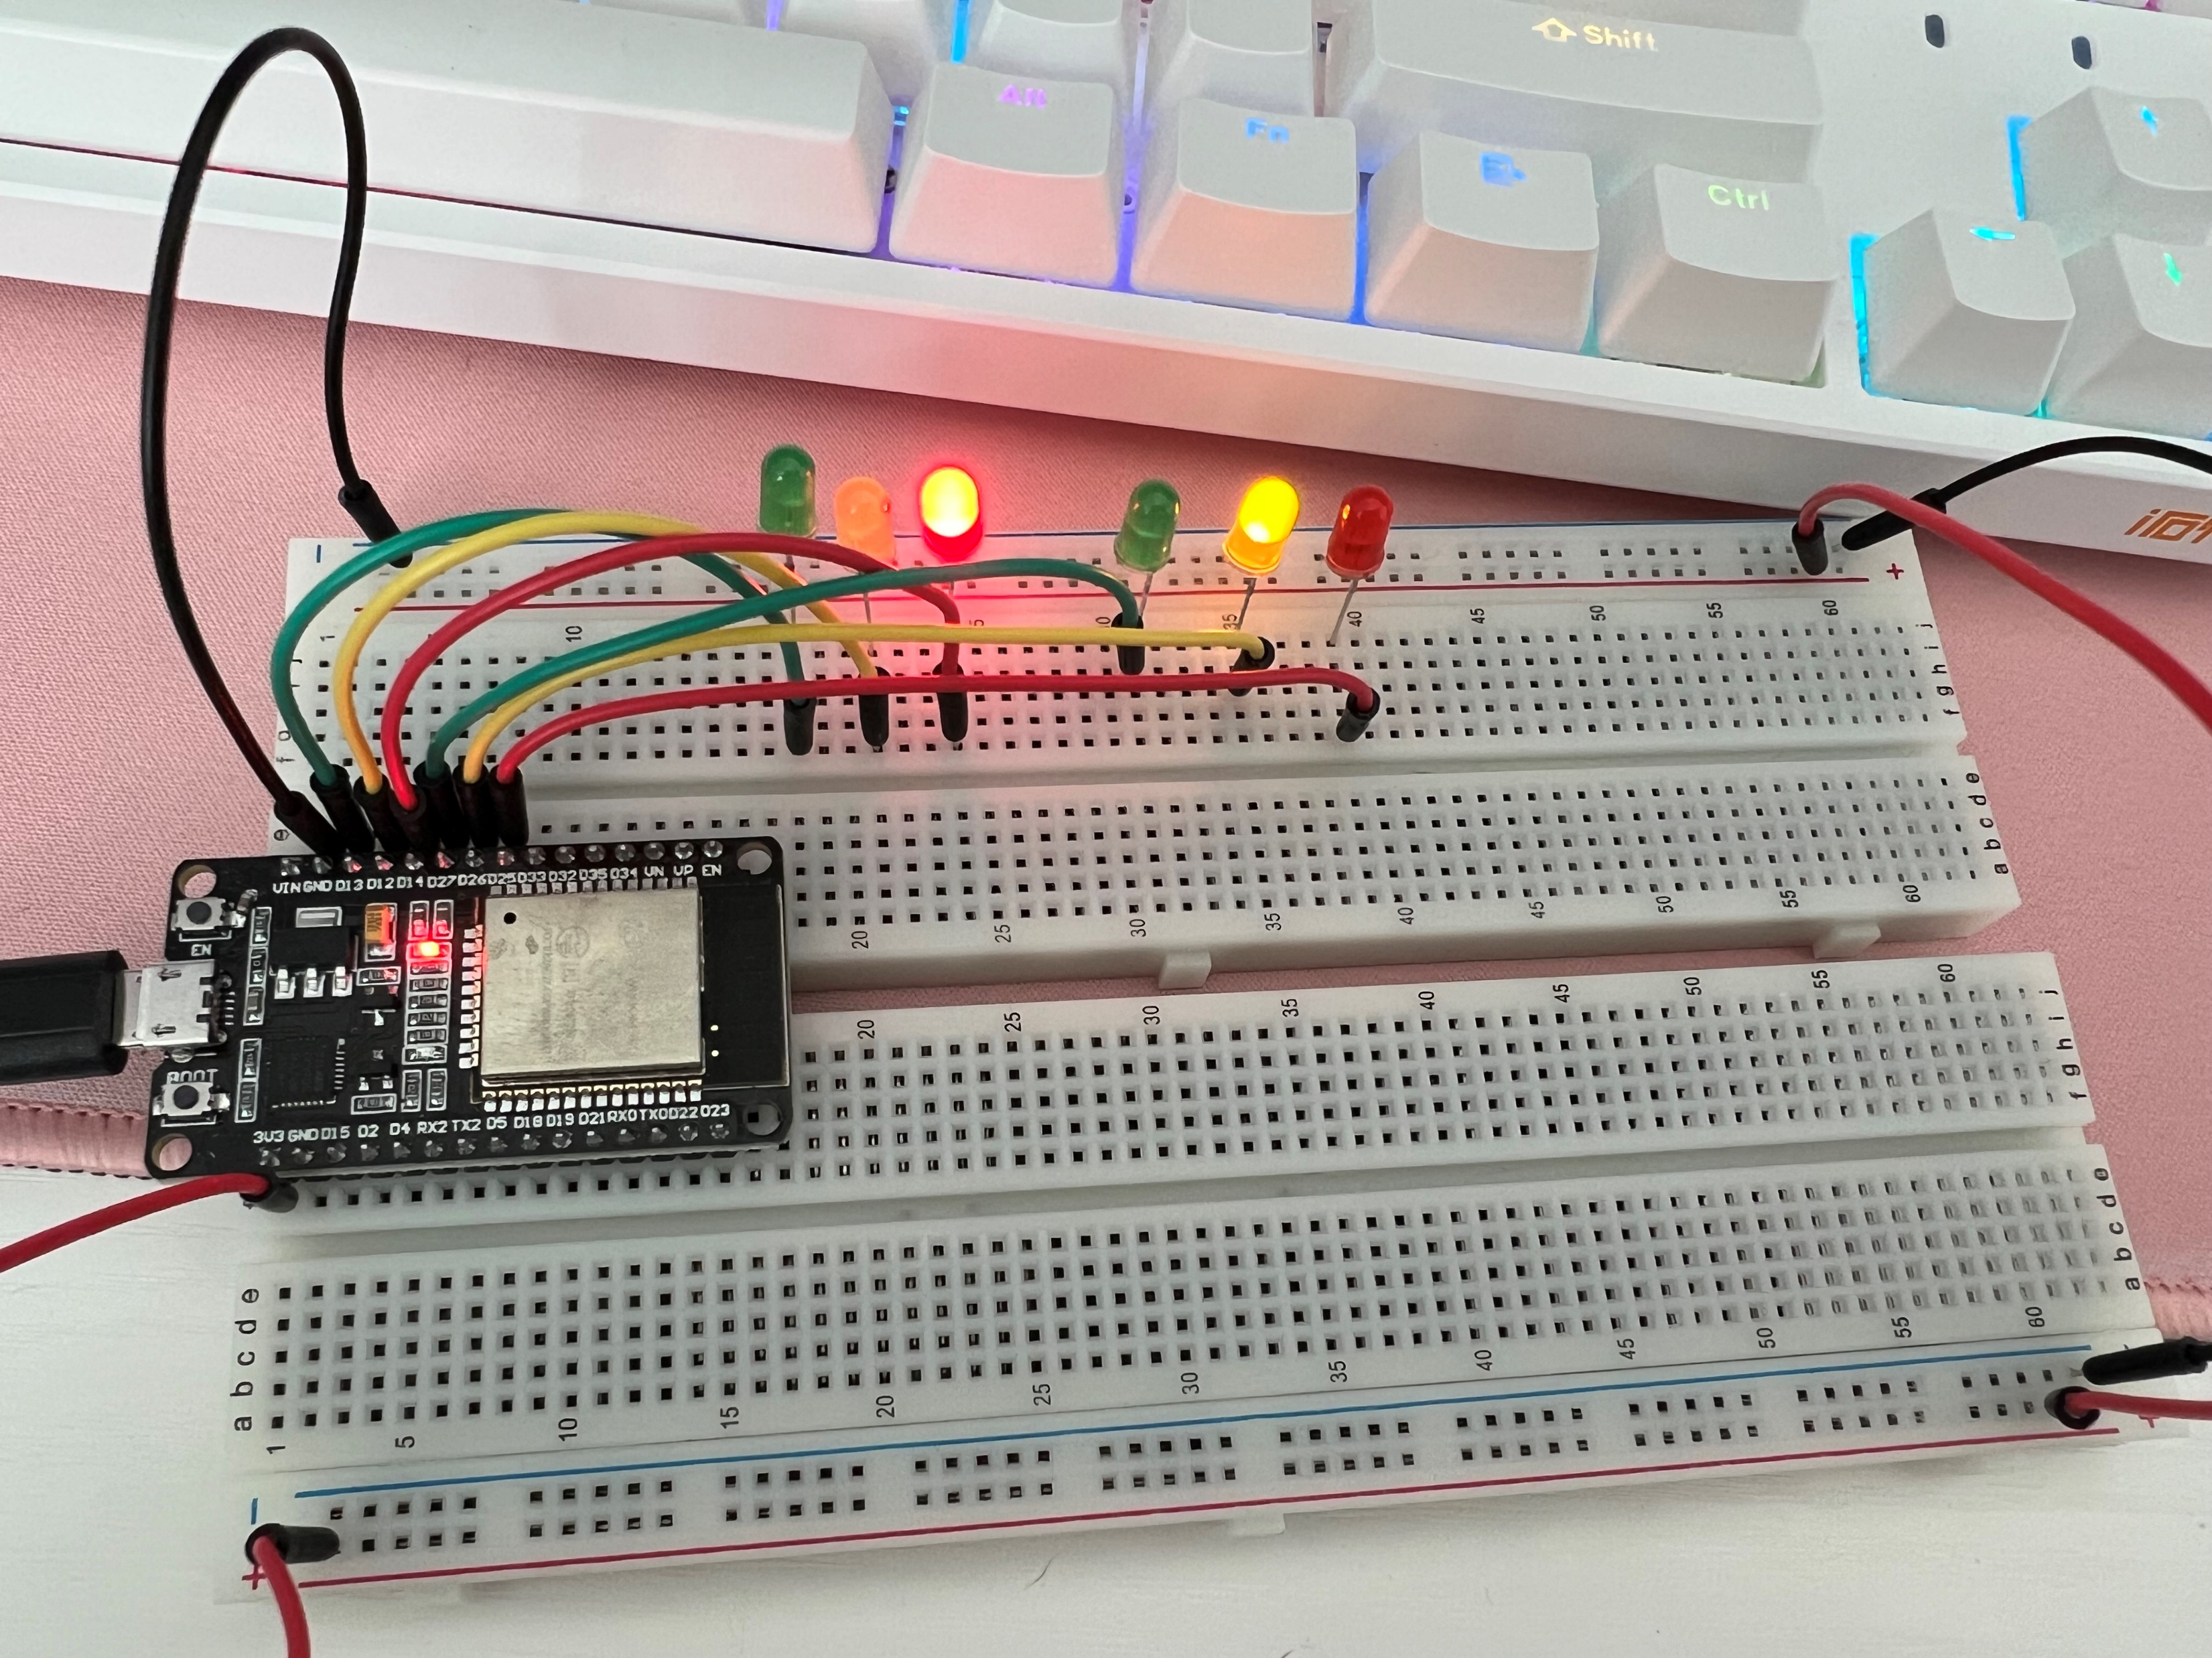
Circuit with working LEDs
Connect the ESP32 Board to your computer and verify if it's recognized by the Arduino IDE.
Insert the three LEDs (Red, Yellow, Green) into the breadboard
Connect wires
Open the Arduino IDE and load the code

Slide 13
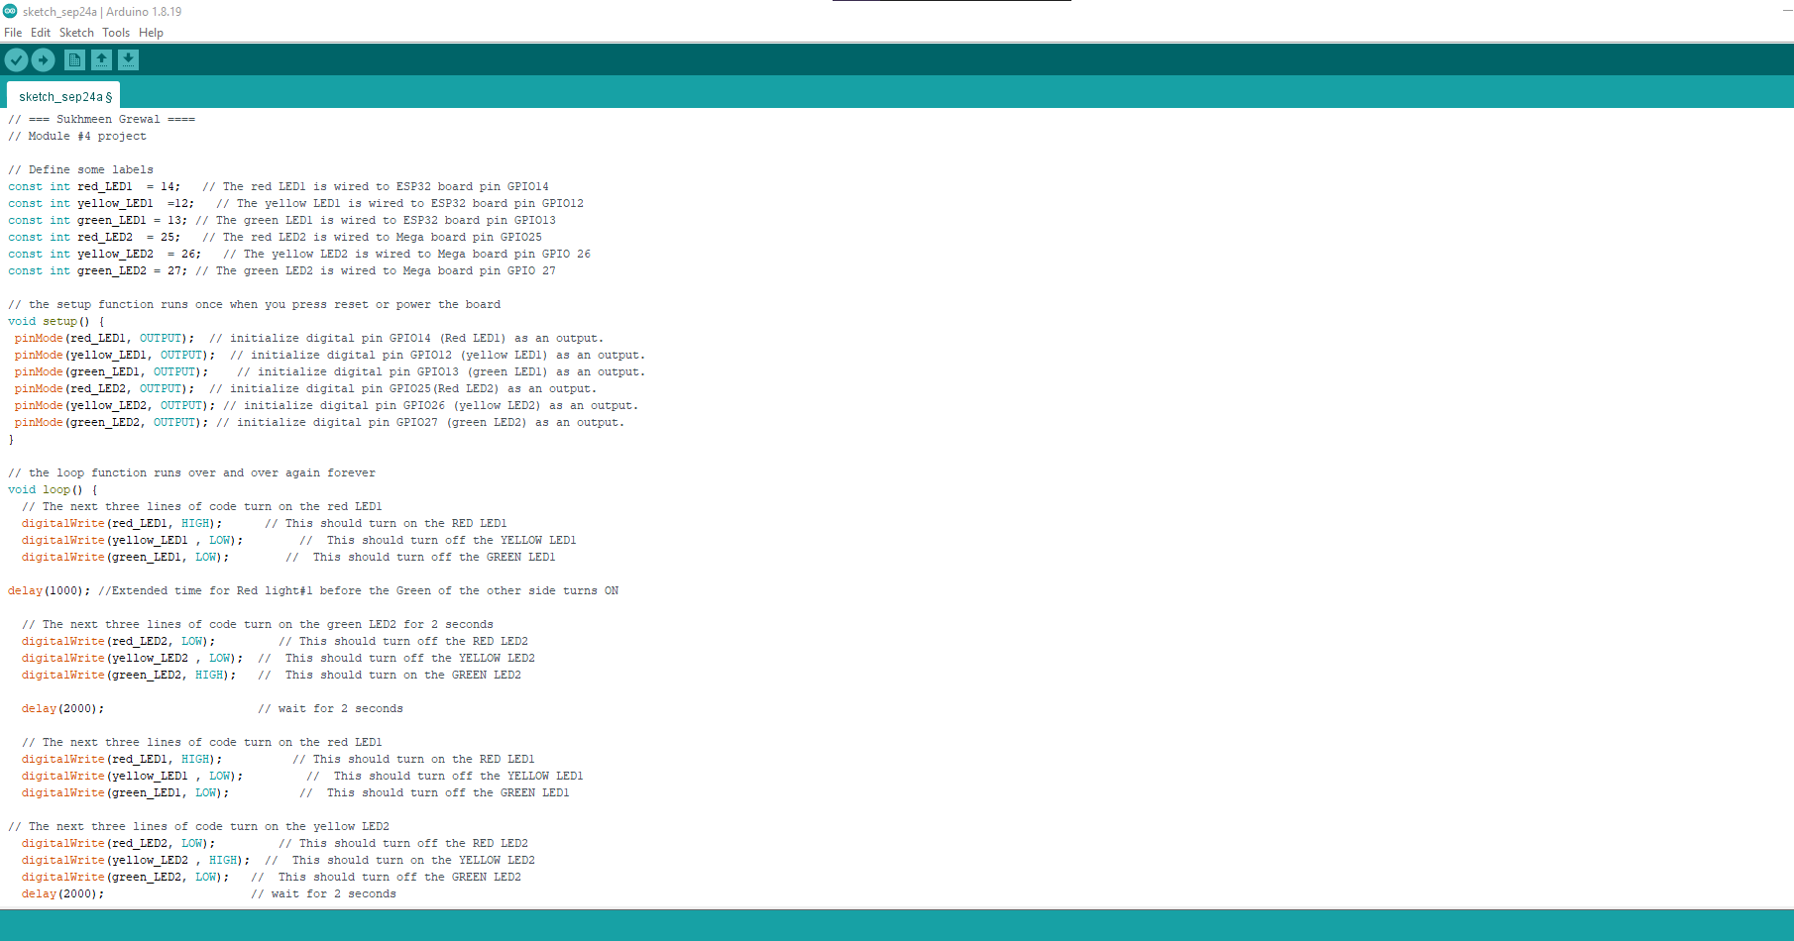
Code in Arduino IDE
Code for Two Traffic Lights

Slide 14
System Integration 1
System Integration is a crucial phase where various components, both hardware and software, are brought together to work harmoniously as a complete system.
Component Identification
Hardware Connection
Compatibility Assurance

Slide 15
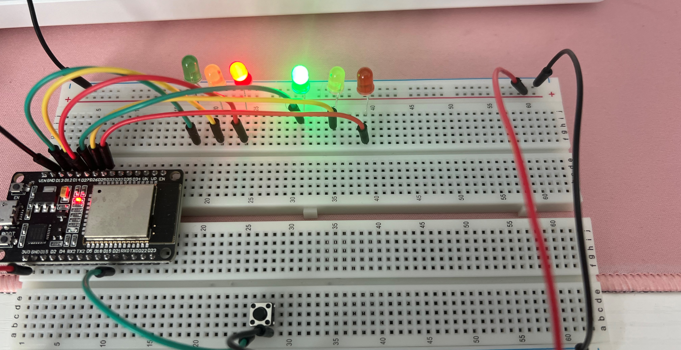
Picture of circuit with working LEDs
Multiple Traffic Lights with Crosswalk Button
Assemble the circuit & connect all the wires

Slide 16
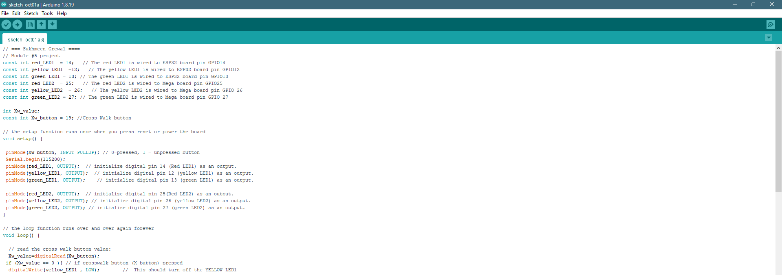
Code in Arduino IDE
Open the Arduino IDE and load the provided cod

Slide 17
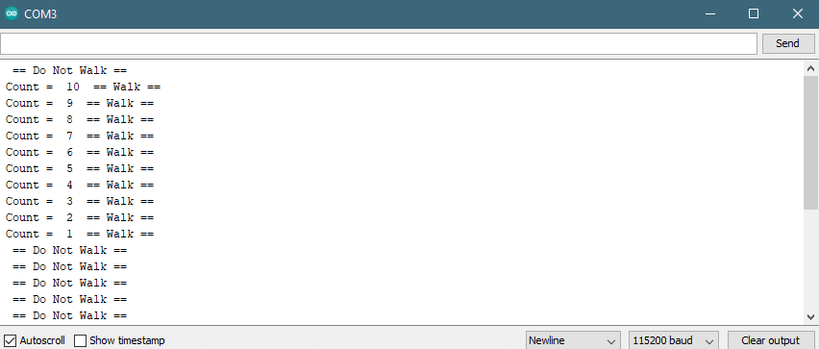
Serial Monitor in Arduino IDE
Run the code and observe the output in the serial monitor for real-time feedback.

Slide 18
System Integration 2
Data Synchronization: Implement mechanisms for data synchronization between various components, ensuring a smooth and uninterrupted flow of information.
Software Interoperability: Address software compatibility, API integration, and data exchange protocols to make different software systems work harmoniously.
Rigorous Testing: Perform comprehensive testing, encompassing functional, performance, and security testing, to identify and resolve integration issues.

Slide 19
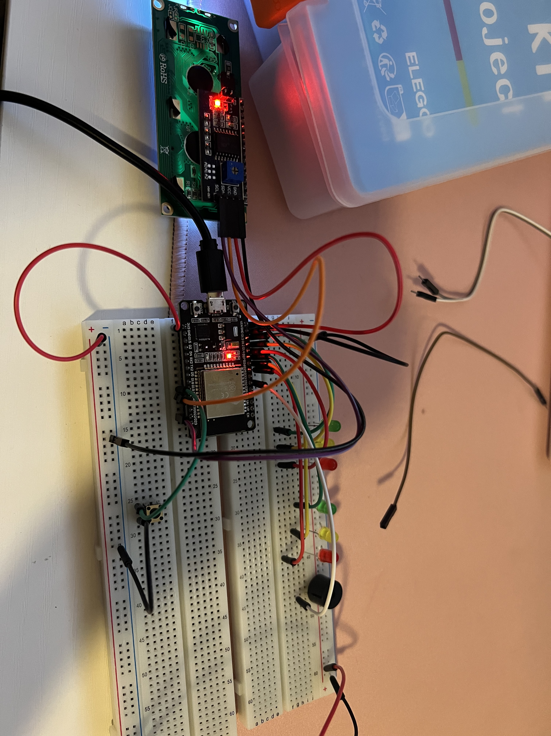
Circuit with working LEDs and LCD display
Multiple Traffic Lights with Crosswalk, buzzer, and LCD display

Slide 20
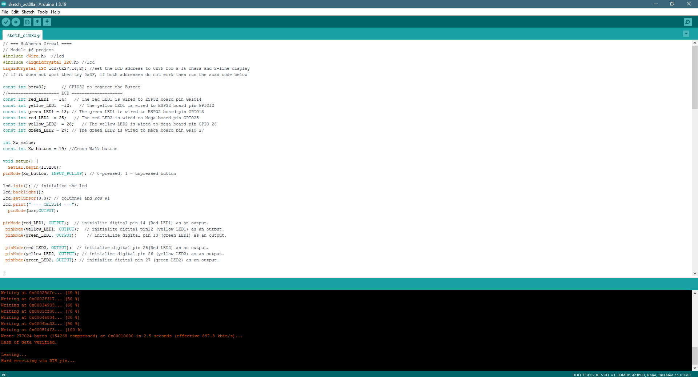
Code in Arduino IDE
Install the LiquidCrystal_I2C-master Library in the Arduino IDE
Code for Two Traffic Lights, Crosswalk, buzzer, and LCD display

Slide 21
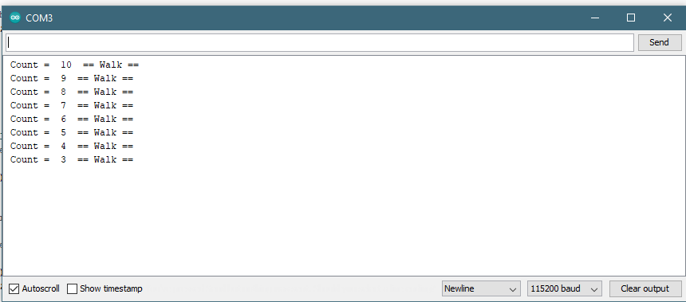
Serial Monitor in Arduino IDE
Observe the output displayed on the LCD Panel and listen for the buzzer's respons

Slide 22
Final Project Component – Option 2
In this project, our primary objective is to design an intelligent traffic light system that optimizes traffic flow and prioritizes safety. To achieve this, we plan to create a traffic light configuration where one direction of the major street enjoys continuous green signals, promoting a smooth and efficient traffic movement. Simultaneously, on the less busy minor street, we intend to keep the traffic light consistently red, minimizing delays and potential congestion. To further enhance safety and responsiveness, we'll integrate motion detectors that can sense the presence of vehicles, subsequently activating the minor street traffic light when motion is detected. Additionally, we'll incorporate push buttons for pedestrians to safely initiate crosswalk signals when needed and for emergency situations, ensuring a swift response when required. By addressing these objectives, we aim to create a more efficient and secure traffic control system that benefits both motorists and pedestrians alike.

Slide 23
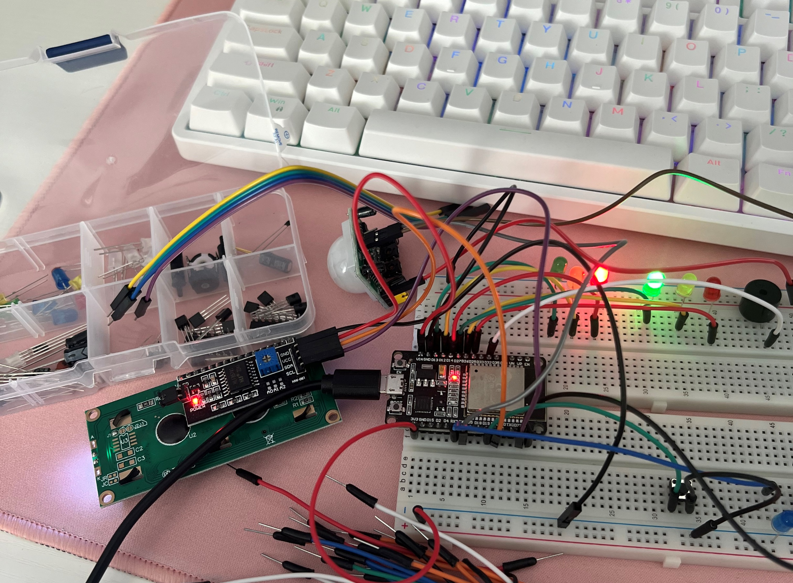
Screenshot of resources (Identification)

Slide 24
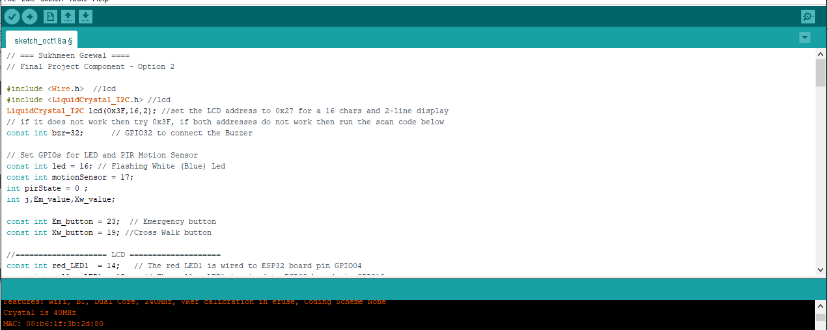
Code in Arduino IDE
Code for Option 2 Final SMART Traffic Light with Motion Detector

Slide 25
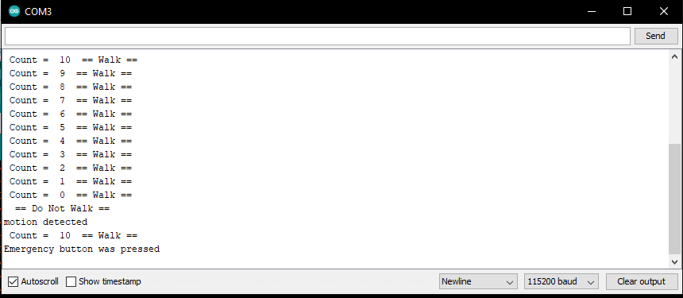
Screenshot of Serial Monitor in Arduino IDE

Slide 26
Conclusion
Digital devices have become an integral part of our daily lives, offering convenience and endless possibilities. They combine both hardware and software to provide useful functions and experiences. From the smartphones that keep us connected to the Internet of Things (IoT) devices that automate our homes, these technologies offer unparalleled convenience. They function by combining both physical hardware and the software that controls it, working in unison to deliver a wide range of functionalities, from entertainment to productivity. By understanding the implications of our digital choices, we can navigate the digital realm with greater confidence and responsibility.

Slide 27
Challenges
Transitioning from Option 1 to Option 2 was necessitated by a significant challenge—software discontinuation. The software previously used had reached its end-of-life, posing limitations on functionality, support, and security. The process highlighted the importance of resilience and adaptability in our digital strategy. We had to embrace change and invest in new tools and training to maintain operational efficiency. While the transition presented challenges, it also brought positive outcomes, including improved software capabilities, enhanced security, and long-term sustainability.

Slide 28
Career Skills
Technical Proficiency
Data management
Problem Solving
Sensors and Actuators
Project Management
IoT ecosystem understanding

Slide 29
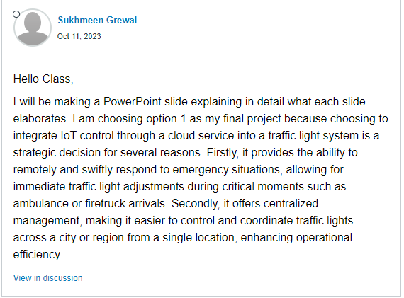
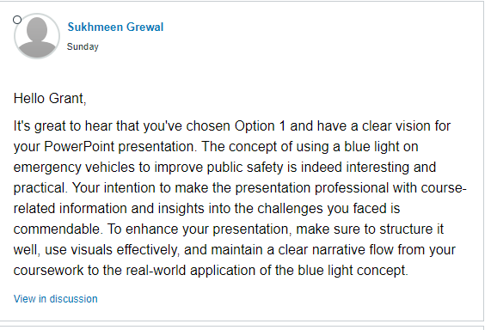
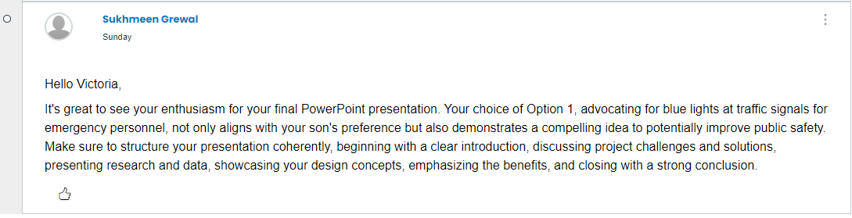
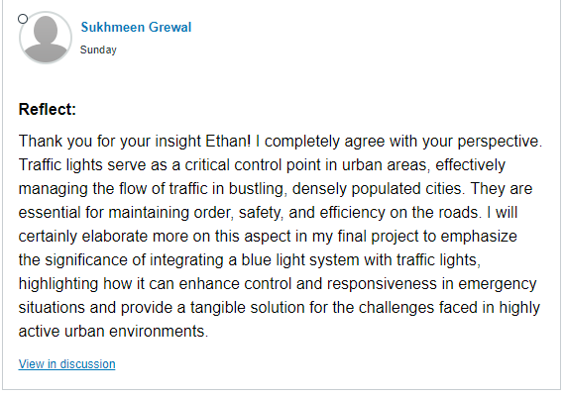
Peer Review and Teamwork
Share
Review
Reflect

Slide 30
References
https://devryu.instructure.com/courses/97748/pages/module-7-final-course-project-due-by-end-of-week-8?module_item_id=12673320
https://offer.connectedsolutions.pwc.com/iot-solutions/?utm_medium=ADV-SEM&utm_source=GOOG&utm_offer=EBOOK&utm_campaign=US_Operational_Improvement_US_2409_CS_IoT_Solutions_EBOOK_ADV-SEM&cid=70169000002KbfQAAS&utm_content=&gclid=CjwKCAjwp8OpBhAFEiwAG7NaEh3zi9LWbNSKCehlI1X_G1gxlyGmdBdsOYDGlpNBy0_2wjeLA2XSBRoCPx8QAvD_BwE
https://www.igi-global.com/dictionary/digital-distractions-note-taking-and-student-learning/93764#:~:text=An%20electronic%20device%20that%20can,mobile%20phones%2C%20and%20tablet%20computers.

